Slide 1
Method Overriding java
Present By:- Uzma Banu

Slide 2
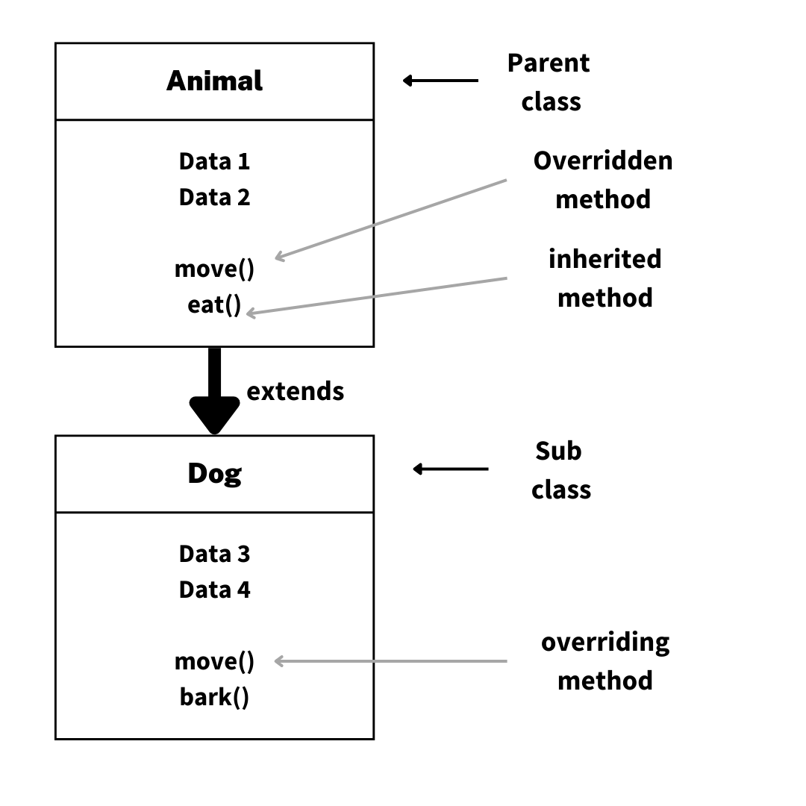
Introduction
Method Overriding occurs when a subclass provides a specific implementation of a method already defined in its parent class.
It allows runtime polymorphism and enables the subclass to provide specific behavior.

Slide 3
Features of Method Overriding
Same Method Name: The method name in the child class must match the parent class.
Same Parameters: The number and type of parameters must be the same.
Requires Inheritance: Happens only between parent and child classes.
Runtime Polymorphism: Decides which method to call at runtime.
@Override Annotation: Optional but helps indicate overriding.
Access Modifier Rule: Child method cannot have stricter access than the parent method.

Slide 4
Syntax of Method Overriding
// Parent Class
class Parent {
void display() {
System.out.println("This is the parent class method.");
}
}
// Child Class
class Child extends Parent {
@Override
void display() {
System.out.println("This is the child class method.");
}
}

Slide 5
Rules for Overriding
The method must have the same signature (name, parameters, and return type).
The overriding method must not have a more restrictive access modifier.
@Override annotation is optional but recommended for better clarity.
Cannot override static or final methods.

Slide 6
Real-Life Example
class Vehicle {
void run() {
System.out.println("Vehicle is running");
}
}
class Bike extends Vehicle {
@Override
void run() {
System.out.println("Bike is running");
}
}
public class Main {
public static void main(String[] args) {
Vehicle v = new Bike(); // Upcasting
v.run(); // Outputs: Bike is running
}
}
Output:-
Bike is running

Slide 7
Advantages and Limitations
Advantages:-
Supports runtime polymorphism.
Enhances code reusability.
Allows specific behavior in subclasses.
Limitations:-
Cannot override static or final methods.
May increase complexity in large projects.

Slide 8
Comparison: Overloading vs Overriding
Aspect | Method Overloading | Method Overriding
Definition | Same name, different params. | Same name, same params.
Polymorphism | Compile-time polymorphism. | Runtime polymorphism.
Classes | Same class. | Parent-Child relationship.

Slide 9

"Programming isn't about what you know; it's about what you can figure out."

Slide 10
Thank You…!

